Slide 1




Predicting the City-Cycle Fuel Consumption in Miles per Gallon of a Car
Data science project Powered by
Dilmperis Emmanouil
Feleskoura Vanesa
Kampili Anastasia-Maria
Kastellos Anestis
Vaidomarkakis Panagiotis
10.22.2021

Slide 2

Contents/index
INTRODUCTION
EXPLORATORY DATA ANALYSIS
PREPROCESSING
MODEL PRESENTATION
RESULTS

Slide 3

INTRODUCTION
PROBLEM
The automotive industry is extremely competitive. With increasing fuel prices and picky consumers, automobile makers are constantly optimizing their processes to increase fuel efficiency.
But, what if you could have a reliable estimator for a car’s mpg given some known specifications about the vehicle?
Then, you could beat a competitor to market by both having a more desirable vehicle that is also more efficient, reducing wasted R&D costs and gaining large chunks of the market.

Slide 4

DATA EXPLORATION
Let’s Dive In

Slide 5
ATTRIBUTES Description
MPG: Miles per Gallon
Cylinders: Number of cylinders
Displacement: Volume of cc in every cylinder
Horsepower: Power of the engine
Weight: Weight in lbs
Acceleration: 0-60 mph in seconds
Model year: Production year
Origin: Production continent
Car Name: Brand and model

Slide 6
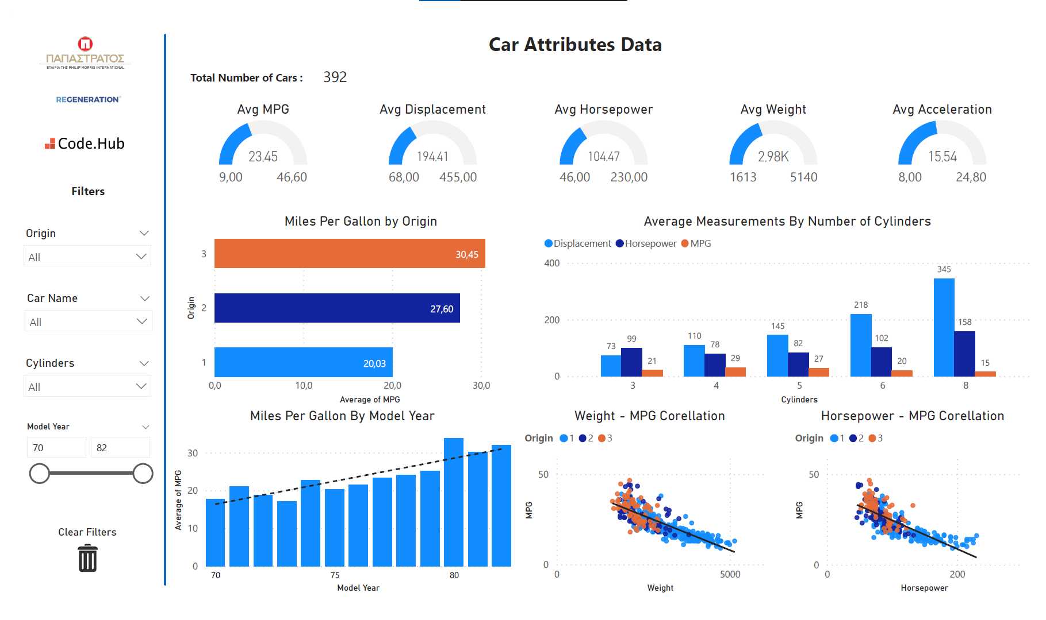
Power bi

Slide 7
Preprocessing
Finding and replacing NaN(Not a Number) values
Correct the list of brands
Encoding string values
Scale values with min max scaler
Adding more columns like model etc

Slide 8
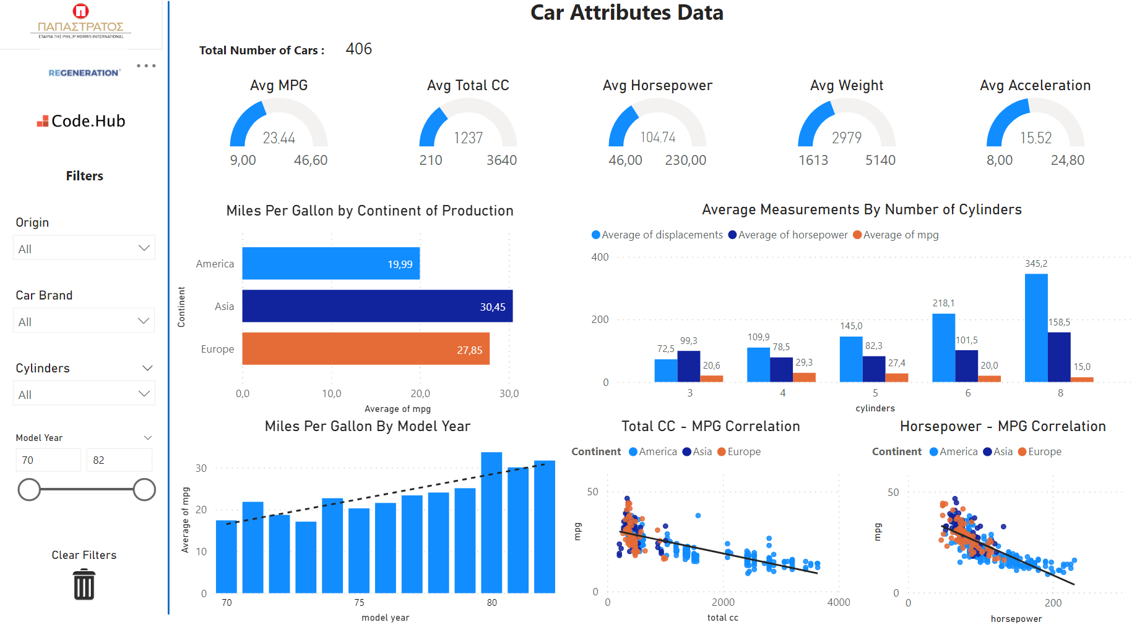
Power bi

Slide 9
MODEL PRESENTATION
LinearRegression()
SGDRegressor()
KNeighborsRegressor()
GaussianProcessRegressor()
PLSRegression()
DecisionTreeRegressor()
ExtraTreeRegressor()
AdaBoostRegressor()
BaggingRegressor()
ExtraTreesRegressor()
GradientBoostingRegressor()
RandomForestRegressor()
SVR()
Running the most common Regression algorithms
Finding best Accuracy
Finding minimum loss
Best model so far: ExtraTreesRegressor()
Best scaler: StandardScaler()
Using Lightgbm algorithm, we were having more consistency at R² loss

Slide 10
RESULTS

Slide 11

What’s next
LOOKING AHEAD

Slide 12

SUMMARY
OUR BUSINESS IS GOOD
Profits are up in the last quarter by 3%
WE’RE GETTING OUR WORK DONE
We finished the consolidation project
WE’RE DELIVERING FOR OUR CUSTOMERS
Customer satisfaction increased from 70 to 80%
OUR CUSTOMERS KEEP COMING BACK
We increased customer retention by 4%

Slide 13


THANK YOU
Data science project Powered by

